Slide 1
Economic Impact of Advancing Women’s Education, Employment & Leadership
Data Science Project
Geraldine Cheung

Slide 2

The Problem: Gender inequality is not only a moral and social issue, but a critical economic challenge. What is the impact on the global economy when women can achieve their full economic potential?
Data:
Outcome: GDP per capita (current US$)
Predictors:
School enrollment, tertiary, female (% gross)
Employment to population ratio, 15+, female (%)
Proportion of seats held by women in national parliaments (%)
Hypotheses: Advancing women’s education, employment, and leadership positively impacts a country’s GDP per capita.
Notes:
The GDP per capita provides a much better determination of living standards as compared to GDP alone

Slide 3
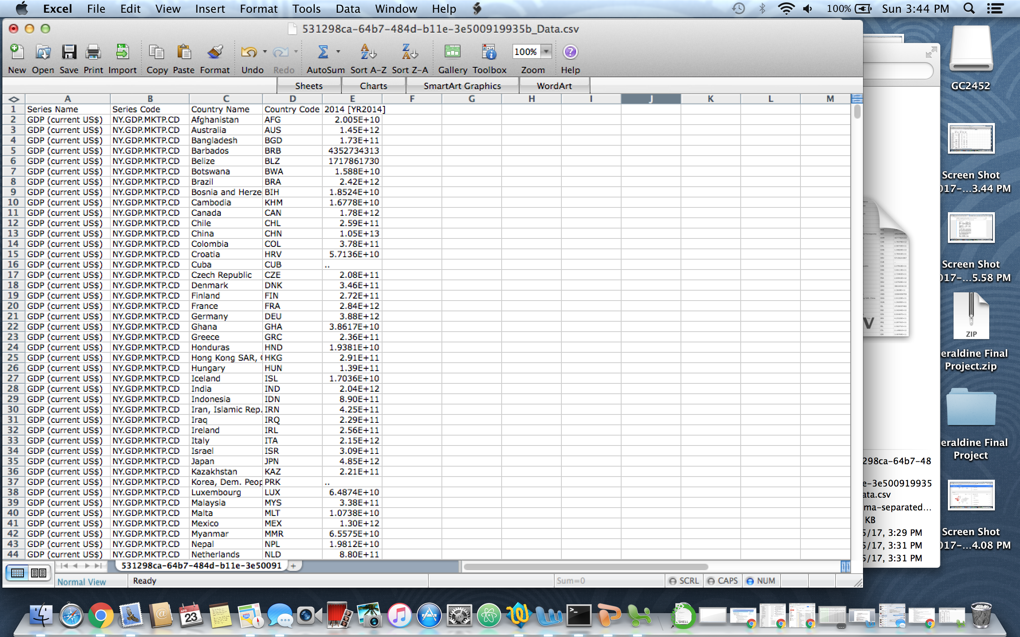
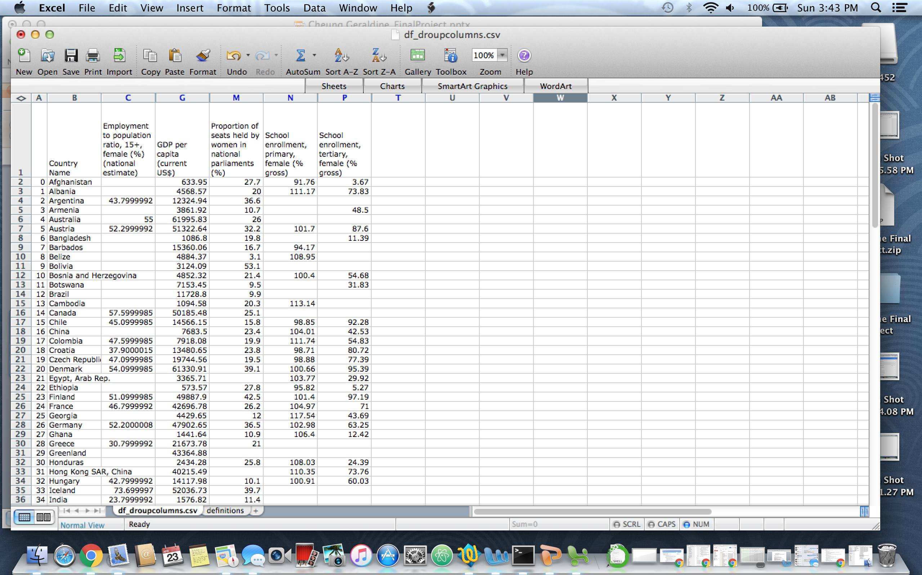
The Data
Raw Data
Refined & Structured Data
80 countries
50 variables
80 countries
5 variables

Slide 4
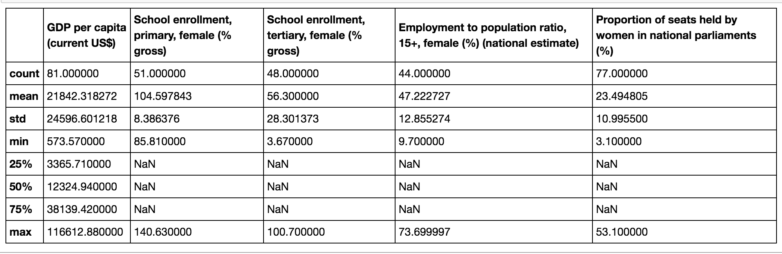
Descriptive Stats

Slide 5
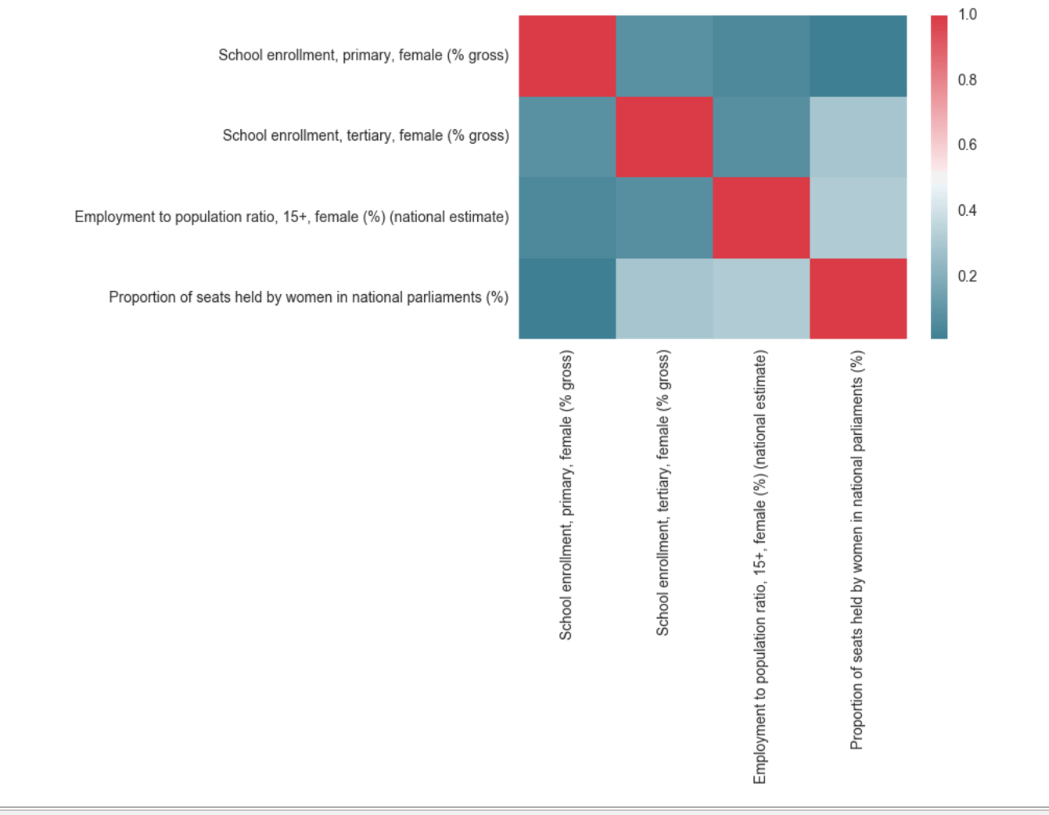
Correlations

Slide 6
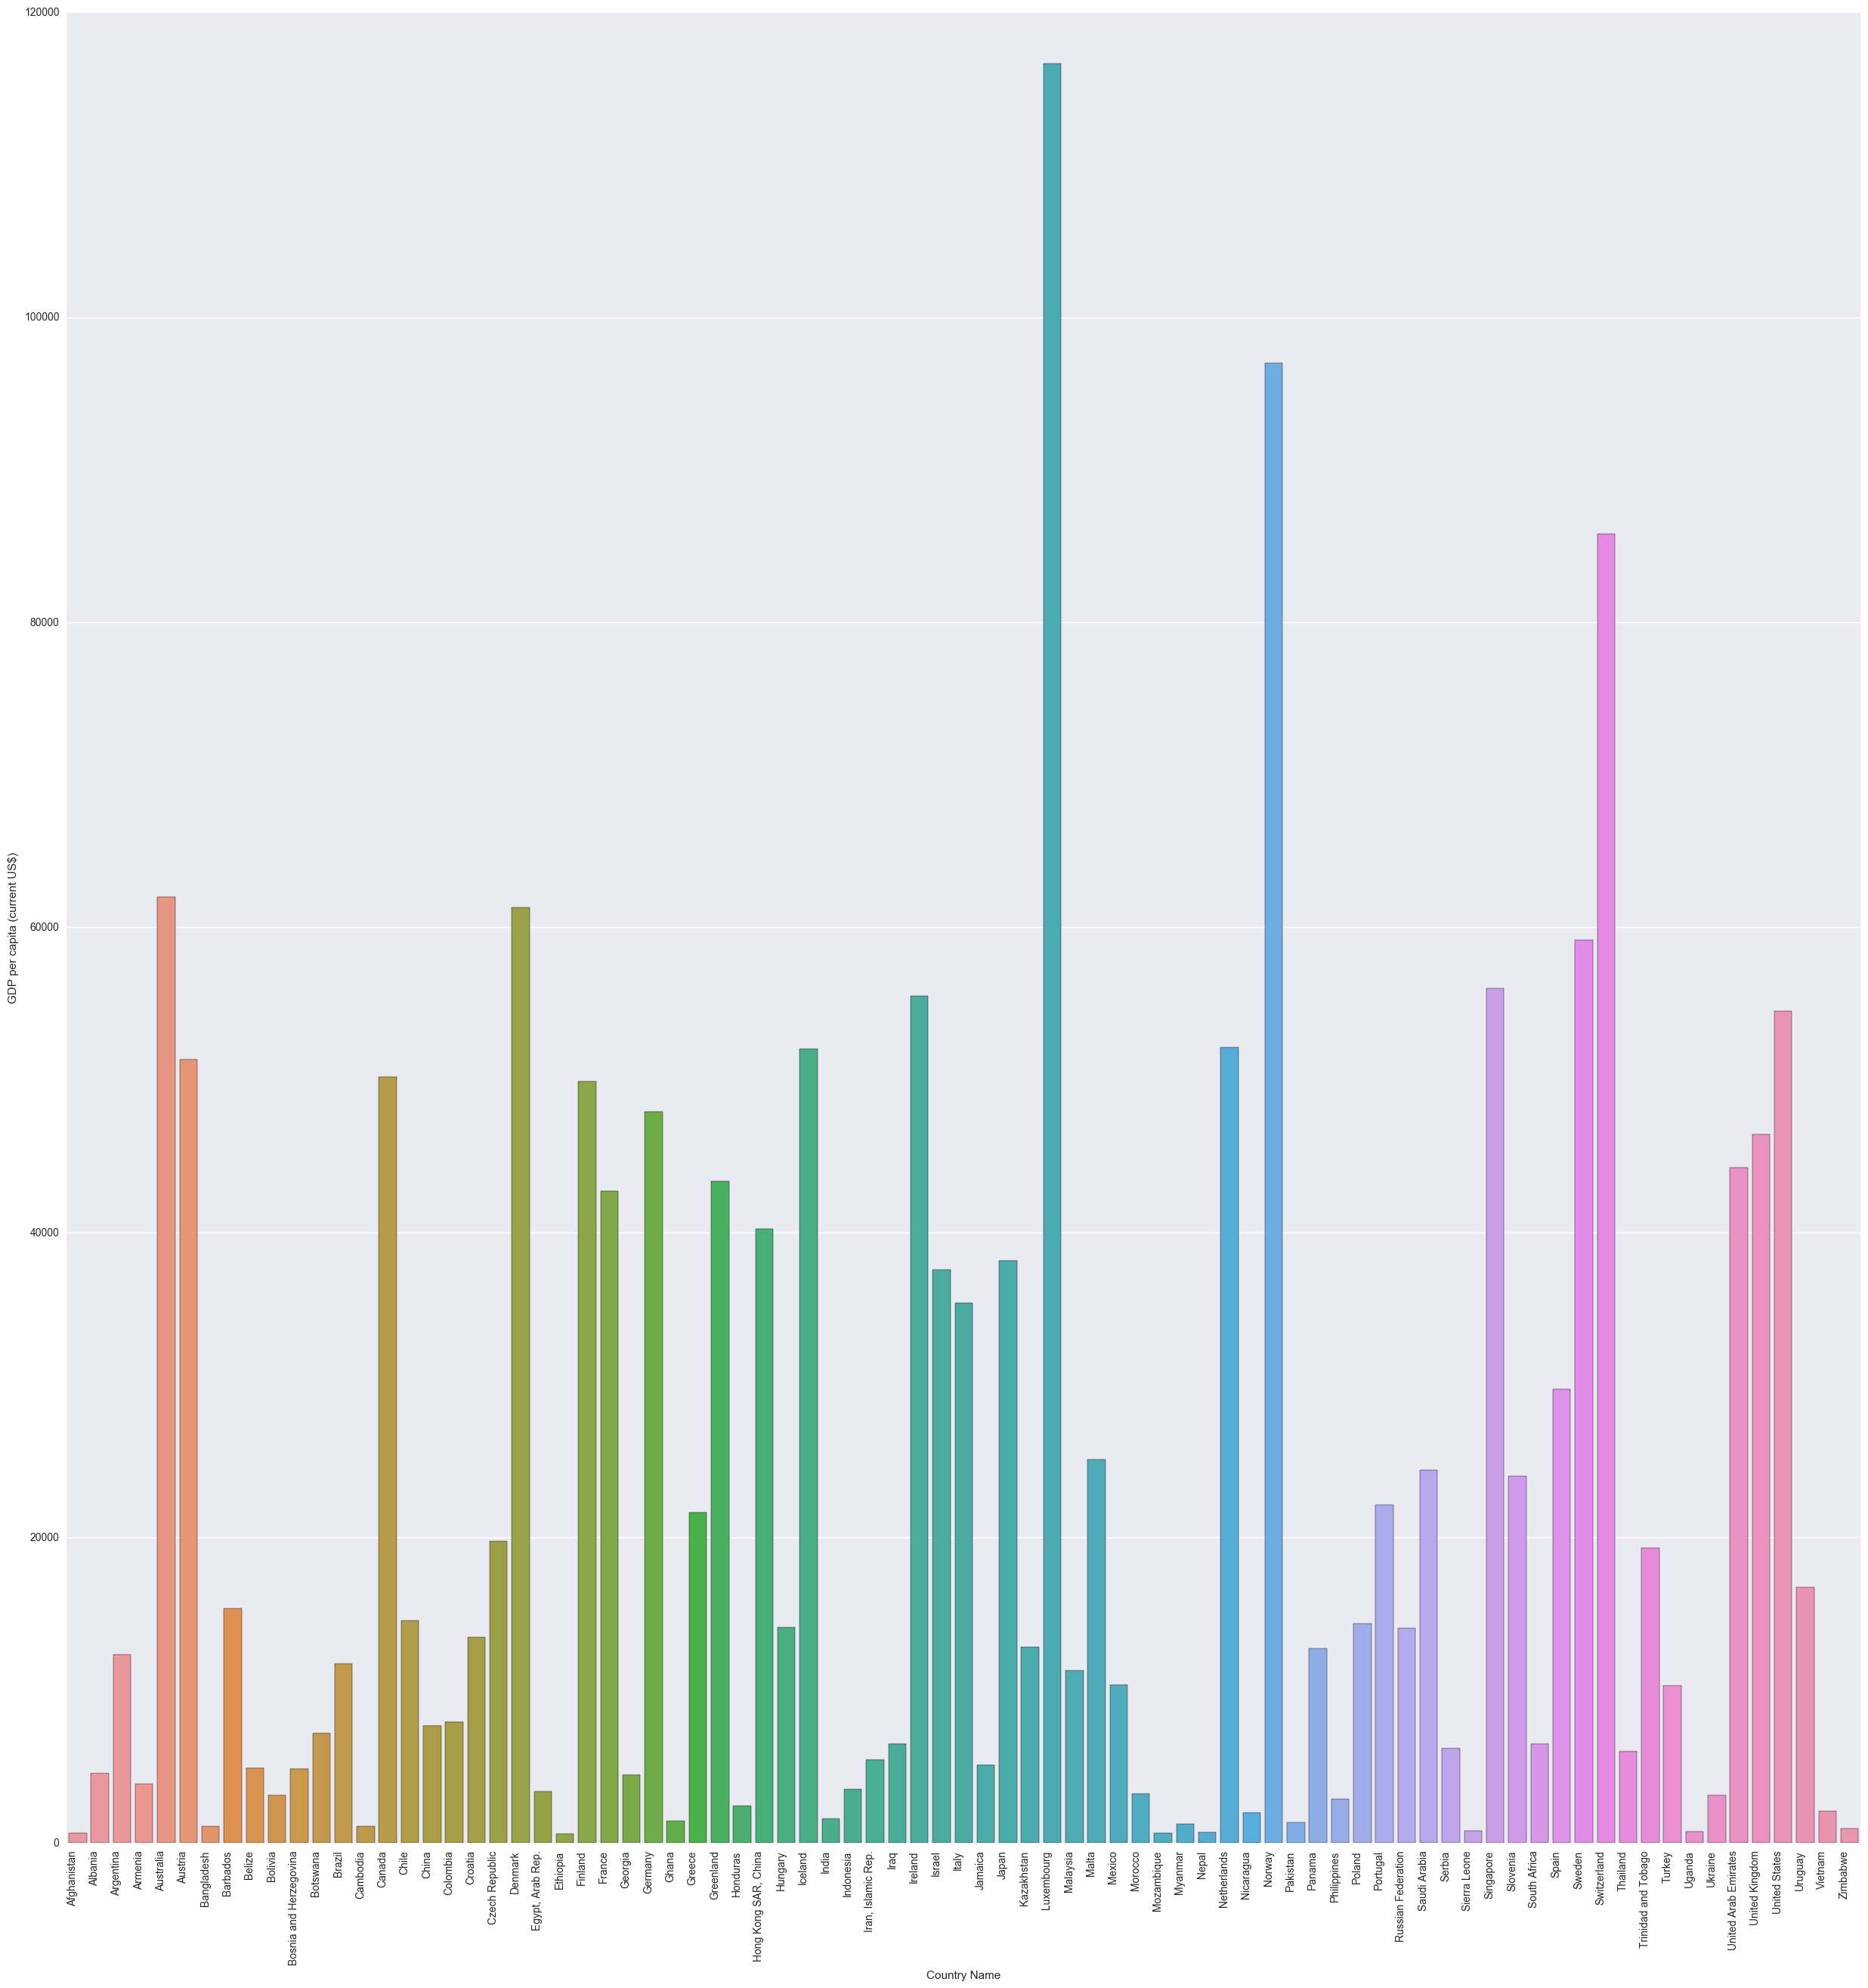
GDP per capita Bar Plot

Slide 7
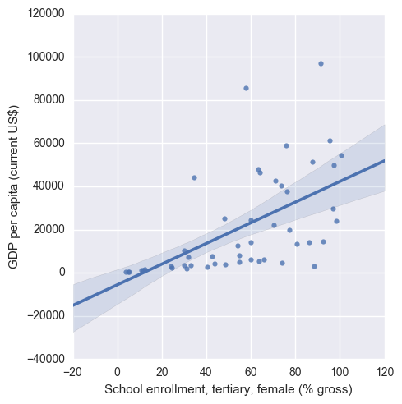
LM Plot - Education

Slide 8
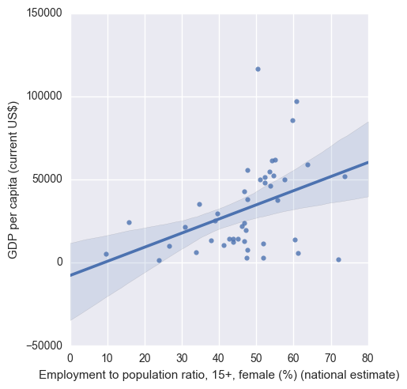
LM Plot - Employment

Slide 9
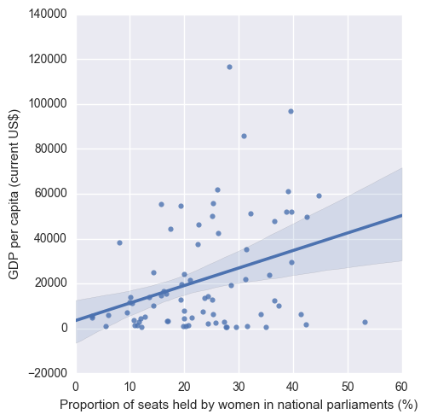
LM Plot - Leadership

Slide 10
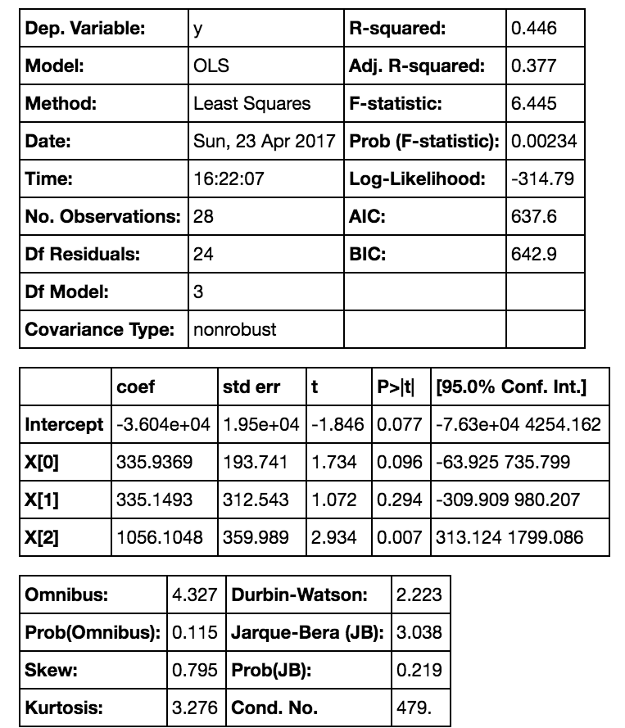
Linear Regression

Slide 11
Conclusion
GDP per capita =
336[TertiaryEducation(%)]
+ 335[FemaleEmployment(%)]
+ 1056[ParliamentSeats(%)]
R² = .446
Only 'Proportion of seats held by women in national parliaments (%)’ was statistically significant

Slide 12
Future Directions
Determine relationship direction
Analyze other metrics:
Ex. Access to healthcare
Cross validate model

